Slide 1
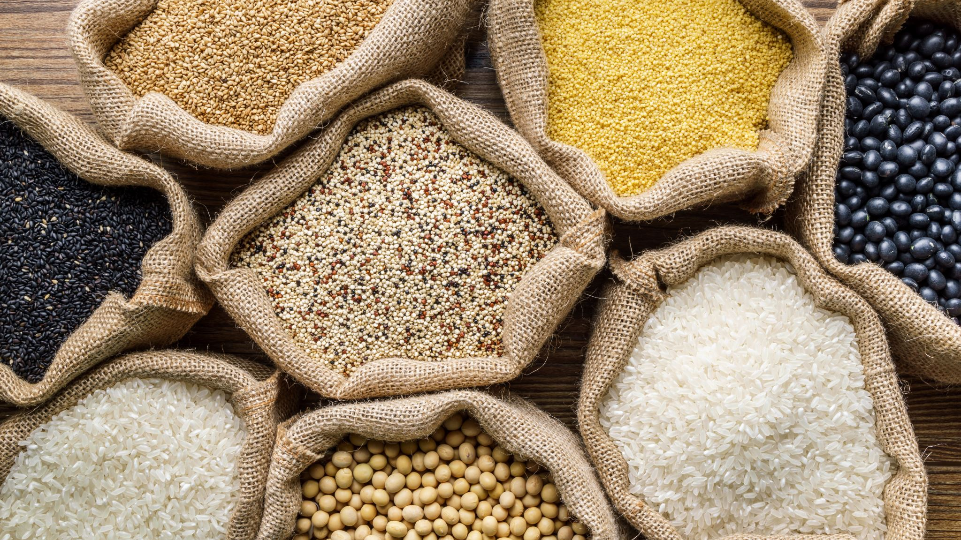
Food Price Prediction in Nepal: Leveraging Data for Stability
An AI-Powered Forecast for Essential Commodities
Submitted By: Sushil Karki
Date: 2025/10/06

Slide 2
Introduction
"Nepal's economy, heavily reliant on agriculture, often faces challenges due to fluctuating food prices. These unpredictable shifts can severely impact both urban consumers struggling with affordability and rural farmers managing their livelihoods. My primary goal was to address this by developing a machine learning solution capable of forecasting future food prices, providing valuable foresight for all stakeholders."

Slide 3
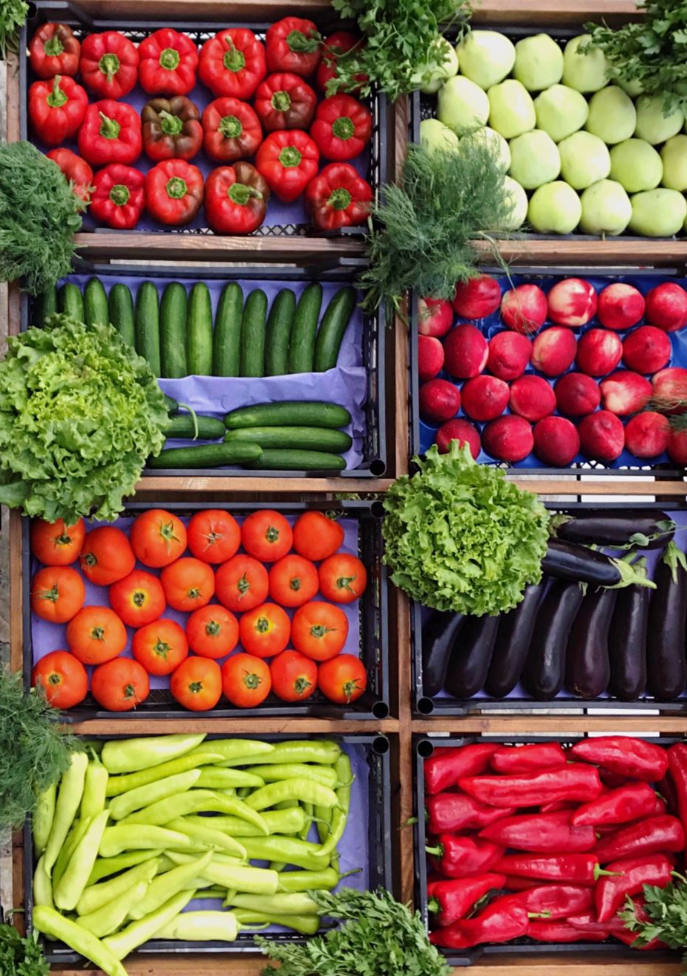
The Challenge & Our Goal
Unpredictable Prices, Vulnerable Communities
Food price volatility significantly impacts households and farmers in Nepal.
Affects purchasing power for consumers.
Lack of timely, accurate price information hinders proactive decision-making.
Goal(Objective): To build a machine learning model that can forecast retail food prices, empowering better planning and response.

Slide 4
Predictive Power with Random Forest Regression : A Machine Learning Approach
Data Collection: https://data.humdata.org/dataset/wfp-food-prices-for-nepal
Model: I utilized a Random Forest Regressor, a robust and widely used machine learning algorithm.
Key Features: My model learns from various factors:
Time-based: Year, month, day, day of week, week of year, quarter.
Geographic: Admin levels, market location (latitude/longitude), market ID.
Commodity Specifics: Category, commodity name, commodity ID, unit, price flag, price type.

Slide 5
Continue…
Performance (on unseen data):
Mean Absolute Error (MAE): Approx. 20.68 NPR (Average prediction error of ~20.68 NPR)
R-squared (R2): Approx. 0.94 (The model explains 94% of the price variation)
Interpretation: A high R2 and relatively low MAE indicate strong predictive capabilities.
Train set size: 34568 rows Test set size: 3841 rows Train dates: 2001-04-15 to 2024-06-15 Test dates: 2024-06-15 to 2025-03-15(90% train, 10% test)

Slide 6
Speaker Note
A solution is powered by a machine learning model – specifically, a Random Forest Regressor. This model was trained on historical WFP food price data from Nepal, leveraging a rich set of features including various time components, detailed geographic information for markets, and specific attributes of each commodity. This allows the model to capture complex patterns like seasonality and regional differences. On unseen test data, This model achieved a Mean Absolute Error of around 20.68 Nepali Rupees, meaning its predictions are, on average, within about 21 rupees of the actual price. More importantly, its R-squared value of 0.94 shows that model can explain 94% of the variability in food prices, which is a very strong indicator of its predictive power.

Slide 7
Dataset Description
2024-06-15 | Province No. 3 | KATHMANDU | Kathmandu | 652 | 27.72 | 85.32 | pulses and nuts | Lentils (broken) | 335 | KG | actual | Retail | NPR | 165 | 1.23
2024-06-15 | Province No. 3 | KATHMANDU | Kathmandu | 652 | 27.72 | 85.32 | pulses and nuts | Peanut | 174 | KG | actual | Retail | NPR | 225 | 1.68
2024-06-15 | Province No. 3 | KATHMANDU | Kathmandu | 652 | 27.72 | 85.32 | vegetables and fruits | Apples | 345 | KG | actual | Retail | NPR | 300 | 2.25
2024-06-15 | Province No. 3 | KATHMANDU | Kathmandu | 652 | 27.72 | 85.32 | vegetables and fruits | Bananas | 254 | Dozen | actual | Retail | NPR | 165 | 1.23
2024-06-15 | Province No. 3 | KATHMANDU | Kathmandu | 652 | 27.72 | 85.32 | vegetables and fruits | Cabbage | 181 | KG | actual | Retail | NPR | 55 | 0.41
2024-06-15 | Province No. 3 | KATHMANDU | Kathmandu | 652 | 27.72 | 85.32 | vegetables and fruits | Carrots | 166 | KG | actual | Retail | NPR | 85 | 0.64
2024-06-15 | Province No. 3 | KATHMANDU | Kathmandu | 652 | 27.72 | 85.32 | vegetables and fruits | Pumpkin | 412 | KG | actual | Retail | NPR | 65 | 0.49
2024-06-15 | Province No. 3 | KATHMANDU | Kathmandu | 652 | 27.72 | 85.32 | vegetables and fruits | Tomatoes | 114 | KG | actual | Retail | NPR | 55 | 0.41
2024-06-15 | Province No. 3 | MAKAWANPUR | Hetauda | 3833 | 27.42 | 85.03 | cereals and tubers | Potatoes (red) | 336 | KG | actual | Retail | NPR | 60 | 0.45
2024-06-15 | Province No. 3 | MAKAWANPUR | Hetauda | 3833 | 27.42 | 85.03 | cereals and tubers | Rice (coarse) | 60 | KG | actual | Retail | NPR | 65 | 0.49
2024-06-15 | Province No. 3 | MAKAWANPUR | Hetauda | 3833 | 27.42 | 85.03 | cereals and tubers | Rice (medium grain) | 131 | KG | actual | Retail | NPR | 80 | 0.6

Slide 8
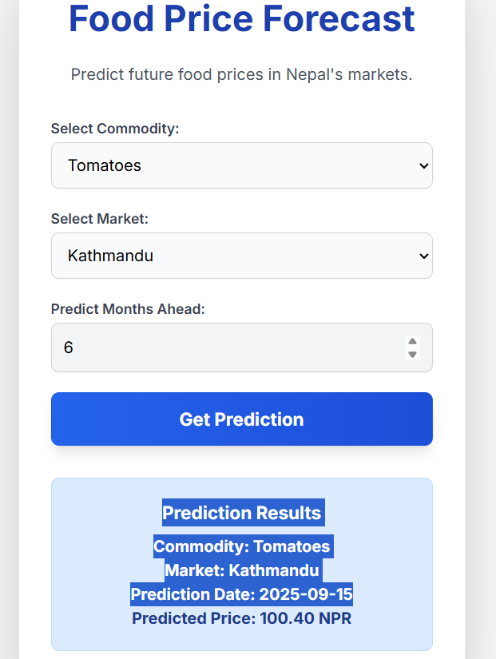
Interactive Price Forecast: A Glimpse into the Future
Select a specific Commodity (e.g., 'Potatoes (red)', 'Meat (chicken)', 'Tomatoes’).
Choose a Market (e.g., 'Birendranagar', 'Dhangadhi', 'Pokhara’).
Specify how many Months Ahead (e.g., 1, 2, 5 months) they want the prediction.

Slide 9
Impact & Future Directions
Empowering Decision-Making & Next Steps
Impact:
Consumers: Better budgeting and purchasing decisions.
Farmers: Informed decisions on planting, harvesting, and selling.
Policymakers: Early warning for potential food crises, facilitating timely intervention.
Humanitarian Aid: More efficient resource allocation for food assistance programs.
Future Enhancements:
Integrate more data sources (weather, conflict, economic indicators).
Explore advanced time-series models (e.g., ARIMA, Prophet).
Develop a mobile application for wider accessibility.
Visualize price trends and predictions directly on maps.

Slide 10
Speaker Note
The impact of such a forecasting tool is far-reaching. It can empower consumers to make more informed purchasing decisions, help farmers optimize their agricultural practices, and provide policymakers with early warnings to prevent or mitigate food price shocks. For organizations like the World Food Programmed, it can lead to more efficient and targeted aid distribution. Looking ahead, I have plan to integrate additional data sources like weather patterns and conflict data to enhance accuracy, explore even more sophisticated time-series models, and develop a mobile application for broader reach, ultimately aiming for a more food-secure Nepal.
Want to learn more about dataset please visit: https://data.humdata.org/dataset/wfp-food-prices-for-nepal
Thank you.

